Slide 1
CUSTOMER ADAPTER

Slide 2
Agenda
1.What is an Adapter.
2.Why do we Need Adapter.
3.Different Types of Adapter.
a. Synchronous
b. Asynchronous
4.The Flow of orders through Adapter to Clearinghouse.
5.Issues and its Resolutions.
6.Where It is Deployed.

Slide 3
What is an Adapter
Adapter sit between the customer's system and the NeuStar Clearinghouse, translating the input XML requests sent from the customer into NeuStar XML format. These requests are then sent to the appropriate Clearinghouse Gateway.

Slide 4
WHY ADAPTER REQUIRED
The Adapter has been designed with the goal of being not only ILEC independent, but also CLEC independent. NeuStar has produced a system that maps CLEC information to NeuStar information that can be sent to the NeuStar ILEC gateways.
To accomplish this goal, the Adapter is designed such that for each CLEC that is brought on as a new customer, XML Style Sheets are created. These XML Style Sheets contain the mapping of fields and data derivation algorithms necessary to generate NeuStar XML.

Slide 5
TYPES OF CUSTOMER ADAPTER
There are different kinds of customer adapters in clearinghouse which are given below
1. Siebel Adapter.
  A. Seibel Av adapter[Synchronous]
  B. Seibel mini adapter[Asynchronous]
2. Comcast Adapter
3. Xo Adapter
4. Portps Adapter
5. Amdocs Adapter
6. Generic Adapter

Slide 6
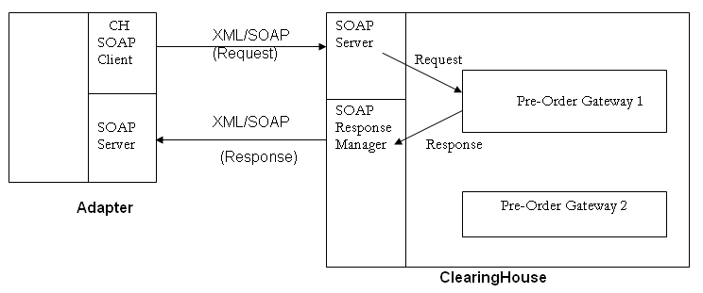

SIEBEL AV ADAPTER[Synchronous Adapter]
Synchronous
SOAP return
Synchronous
SOAP return

Slide 7
Communication Interface
    The communication interface between Siebel system and the adapter is SOAP.
    The standard CH-SOAP server SOAPRequestHandler will receive the request from the Siebel SOAP client by a synchronous SOAP call.
    After processing the request by adapter request chain, to forward the request to Clearing House gateways a CHSoapClient needs to be added at the end of the adapter chain. Configure its property END_POINT_URL to the appropriate URL of ClearingHouse to submit request.

Slide 8
The Flow of orders through the Adapter To Clearinghouse
SyncCORBAServer
Async to Sync Request Driver
GetNextValOfSequence
ReqXSLProcessor
ResolveSupplier
HeaderGenerator
GetAndSet
SetIdentifiers
GetInterfaceVersion
CHReqHandlerClient
XMLQueueConsumer
RespGetAndSet
ResponseMapper
COMM_SERVER

Slide 9
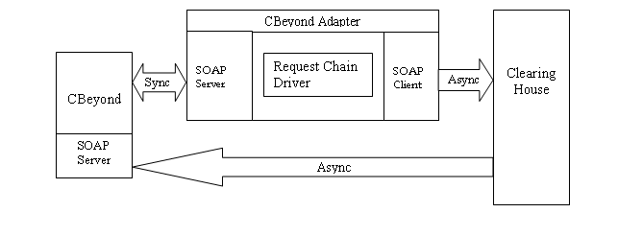
CBeyond LSR ADAPTER[Asynchronous Adapter]

Slide 10
Communication Interface
    1.The communication interface between CBeyond and the adapter would be SOAP.
    2.The CBeyond LSR adapter would accept XML request synchronously from CBeyond.
    3.No conversion is needed for the request XML received from Cbeyond as CBeyond would be sending standard CH Basic Header.
    4.Adapter would submit the XML request to CH asynchronously.
    5.Responses would be posted directly to CBeyond’s web service by CH SoapResponse manager and mini adapter would not come into picture for any Responses .

Slide 11
Communication Interface
The complete processing in CBeyond LSR adapter would be executed by following driver chains:
  1. Adapter Receive Chain
  2. Receive chain Error Handler
  Adapter Receive Chain:
  In case of successful submission of order to the CH, an ACK would be returned by the adapter to the calling client with Order-Id.
  The Order-Id is generated by an Oracle sequence.
  In case of a system-error from Clearinghouse same would be returned to CBeyond whereas in case of Business Rule error the request would be resubmitted to Clearinghouse with Action='Save'. Later, this order would be searchable via Clearinghouse GUI.

Slide 12
Communication Interface
Receive Chain Error Handler
In case of any Validation Error or System Error, Receive chain error handler sub-flow is called
In case of validation error, the sub-flow resubmit the order to CH with Action=‘save’.
Also the BR errors are returned to Cbeyond. A CBeyond user can then search for saved orders, validate, correct and resubmit via the CH GUI.
In case of System error, sub-flow is terminated and error is returned to CBeyond.

Slide 13
Issues
1.If Responses are failure or not processing in responsemessagequeue Table for Cbeyond customer.
Resolution:
Check the connectivity of Cbeyond System.
If connectivity is alive, then reflowed the orders by setting status to failure and errorcount to 0.
If the orders are still not going, there may have some problem with Cbeyond System.
Send out a mail to OSS Help desk to check with Cbeyond.

Slide 14
Where Customer Adapter Deployed
CTE:stossctgw30[156.154.33.59]
PROD:stossprza10[209.173.61.57]

Slide 15
END
        THANK YOU

